Slide 1
Greedy Algorithms

Slide 2
Greedy Algorithms
Similar to dynamic programming. Used for optimization problems.
Optimization problems typically go through a sequence of steps, with a set of choices at each step.
For many optimization problems, using dynamic programming to determine the best choices is overkill (过度的杀伤威力).
Greedy Algorithm: Simpler, more efficient

Slide 3
Greedy Algorithms
1, the activity-selection problem （活动安排）
2, basic elements of the GA; knapsack prob.（贪婪算法的基本特征；背包问题）
3, an important application: the design of data compression (Huffman) codes. （哈夫曼编码）

Slide 4
First example: Activity Selection
Horseback Riding (骑马)
Canoeing(独木舟)
Surfing(冲浪)
Driving
Swimming
Rock Climbing(攀岩)
9 | 10 | 11 | 12 | 13 | 14 | 15 | 16 | 17
How to make an arrangement to have the more activities?
S1. Shortest activity first （最短活动优先原则）
Swimming , Driving
S2. First starting activity first （最早开始活动优先原则）
Horseback Riding , Driving
S3. First finishing activity first （最早结束活动优先原则）
Swimming , Rock Climbing , Surfing

Slide 5






An activity-selection problem
n activities require
exclusive use of a common resource.
Example, scheduling the use of a classroom.
（n 个活动，1 项资源，任一活动进行时需唯 一占用该资源）
Set of activities S = {a₁, a₂, . . . , a_{n}}.
a_{i} needs resource during period [s_{i} , f_{i} ), which is a half-open interval, where s_{i} is start time and f_{i} is finish time.
Goal: Select the largest possible set of nonoverlapping (mutually compatible) activities. （安排一个活动计划，使得相容的活动数目最多）
Other objectives: Maximize income rental fees , …

Slide 6
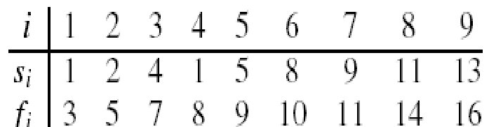

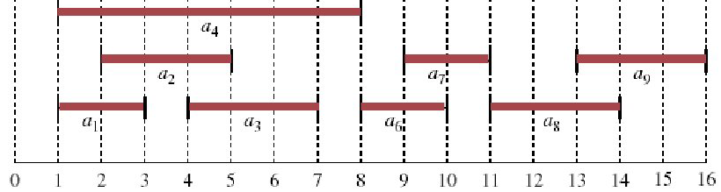
An activity-selection problem
n activities require exclusive use of a common resource.
Set of activities S = {a₁, a₂, . . . , a_{n}}
a_{i} needs resource during period [s_{i} , f_{i} )
Example: S sorted by finish time:
Maximum-size mutually compatible set:
{a₁ , a₃ , a₆ , a₈}.
Not unique: also
{a₂ , a₅ , a₇ , a₉}.

Slide 7
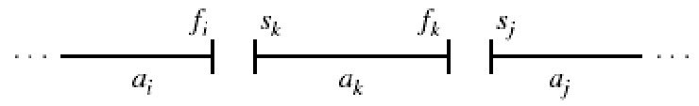
Optimal substructure of activity selection
Space of subproblems
S_{ij} = {a_{k} ∈ S : f_{i} ≤ s_{k} < f_{k} ≤ s_{j} }= activities that start after a_{i} finishes & finish before a_{j} starts
Activities in S_{ij} are compatible with
all activities that finish by f_{i} （完成时间早于f_{i} 的活动）, and
all activities that start no earlier than s_{j} .
To represent the entire problem, add fictitious activities:
a₀ = [﹣∞, 0); a_{n+1} = [∞, “∞+1”)
We don’t care about ﹣∞ in a₀ or “∞+1” in a_{n+1}.
Then S = S_{0,n+1}. Range for S_{ij} is 0 ≤ i, j ≤ n + 1.

Slide 8
Optimal substructure of activity selection
Space of subproblems
S_{ij} = {a_{k} ∈ S : f_{i} ≤ s_{k} < f_{k} ≤ s_{j} }
Assume that activities are sorted by monotonically increasing finish time（以结束时间单调增的方式对活动进行排序）
f₀ ≤ f₁ ≤ f₂ ≤ · · · ≤ f_{n} < f_{n+1} (if i ≤ j, then f_{i} ≤ f_{j}) (16.1)
11
10
9
8
7
6
5
4
3
2
1
0 | 1 | 2 | 3 | 4 | 5 | 6 | 7 | 8 | 9 | 10 | 11 | 12 | 13 | 14

Slide 9
Optimal substructure of activity selection
If f₀ ≤ f₁ ≤ f₂ ≤ · · · ≤ f_{n} < f_{n+1} (if i ≤ j, then f_{i} ≤ f_{j}) (16.1)
Then i ≥ j ⇒Sij = Ø
Proof If there exists a_{k} ∈ S_{ij} , then
f_{i} ≤ s_{k} < f_{k} ≤ s_{j} < f_{j} ⇒ f_{i} < f_{j} .
But i ≥ j ⇒ f_{i} ≥ f_{j} . Contradiction.
So only need to worry about S_{ij} with 0 ≤i <j≤ n + 1.
All other S_{ij} are Ø

Slide 10
Optimal substructure of activity selection
Suppose that a solution to S_{ij} includes a_{k} . Have 2 sub-prob
S_{ik} (start after a_{i} finishes, finish before a_{k} starts)
S_{kj} (start after a_{k} finishes, finish before a_{j} starts)
Solution to S_{ij} = (solution to S_{ik} )∪{a_{k}}∪(solution to S_{kj} )
Since a_{k} is in neither of the subproblems, and the subproblems are disjoint, | solution to S | = | solution to S_{ik} | + 1 + | solution to S_{kj} | .
Optimal substructure: If an optimal solution to S_{ij} includes a_{k} , then the solutions to S_{ik} and S_{kj} used within this solution must be optimal as well. (use usual cut-and-paste argument).
Let A_{ij} = optimal solution to S_{ij} ,
so A_{ij} = A_{ik}∪{a_{k}}∪A_{kj} , (16.2)
assuming: S_{ij} is nonempty; and we know a_{k} .

Slide 11
A recursive solution
Let c[i, j ] = size of maximum-size subset of mutually compatible activities in Sij .（c[i,j] 表示 Sij 相容的最大活动数）
i ≥ j ⇒ S_{ij} = | ⇒ c[i, j ] = 0.
If S_{ij} ≠ |, suppose that a_{k} is used in a maximum-size subsets of mutually S_{ij} . Then c[i, j] = c[i, k] + 1 + c[k, j ] .
But of course we don’t know which k to use, and so
Why this range of k? Because S_{ij} = {a_{k}∈S: f_{i} ≤ s_{k} < f_{k} ≤ s_{j} }⇒a_{k} can’t be a_{i} or a_{j} .
0 , if S_{ij} = Ø (16.3)
c[i, j] =
max{c[i, k ] + c[k , j ] + 1} , if S_{ij} ≠ Ø
i <k<j
a_{k} ∈ S_{ij}

Slide 12
Converting a DP solution to a greedy solution
0 , if S_{ij} = Ø (16.3)
c[i, j] =
max{c[i, k ] + c[k , j ] + 1} , if S_{ij} ≠ Ø
i <k<j
a_{k} ∈ S_{ij}
It may be easy to design an algorithm to the problem based on recurrence (16.3).
Direct recursion algorithm (complexity?)
Dynamic programming algorithm (complexity?)
Can we simplify our solution?

Slide 13
Converting a DP solution to a greedy solution
Theorem 16.1
Let S_{ij} ≠ Ø, and let a_{m} be the activity in S_{ij} with the earliest finish time: f_{m} = min {f_{k} : a_{k} ∈ S_{ij} }. Then
a_{m} is used in some maximum-size subset of mutually compatible activities of S_{ij} .（a_{m} 包含在某个最大相容活动子集中）
S_{im} = Ø , so that choosing a_{m} leaves S_{mj} as the only nonempty subproblem. （仅剩下一个非空子问题 S_{mj} ）
11
10
9
8
7
6
5
4
3
2
1
0 | 1 | 2 | 3 | 4 | 5 | 6 | 7 | 8 | 9 | 10 | 11 | 12 | 13 | 14

Slide 14
Converting a DP solution to a greedy solution
Theorem 16.1
Let S_{ij} ≠ Ø , and let am be the activity in S_{ij} with the earliest finish time: f_{m} = min {f_{k} : a_{k} ∈ S_{ij} }. Then
a_{m} is used in some maximum-size subset of mutually compatible activities of S_{ij} .（a_{m} 包含在某个最大相容活动子集中）
S_{im} = Ø , so that choosing a_{m} leaves S_{mj} as the only nonempty subproblem. （仅剩下一个非空子问题 S_{mj} ）
Proof
Suppose there is some a_{l} ∈ S. Then f_{i} < s_{l} < f_{l} ≤ s_{m} < f_{m} ⇒ f_{l} < f_{m} Then a_{l} ∈ S_{ij} and it has an earlier finish time than f_{m} , which contradicts our choice of a_{m} . Therefore, there is no a_{l} ∈ S_{im}⇒ S_{im} = Ø.

Slide 15
Converting a DP solution to a greedy solution
Theorem 16.1
Let S_{ij} ≠ Ø , and let am be the activity in S_{ij} with the earliest finish time: f_{m} = min {f_{k} : a_{k} ∈ S_{ij} }. Then
a_{m} is used in some maximum-size subset of mutually compatible activities of S_{ij} .（a_{m} 包含在某个最大相容活动子集中）
Proof
Let A_{ij} be a maximum-size subset of mutually Compatible activities in S_{ij} . Order activities in A_{ij} in monotonically increasing order of finish time. Let a_{k} be the first activity in A_{ij} .
If a_{k} = a_{m} , done (a_{m} is used in a maximum-size subset).
Otherwise, construct B_{ij}=A_{ij} -{a_{k}}∪{a_{m}} (replace a_{k} by am). Activities in B_{ij} are disjoint. (Activities in A_{ij} are disjoint, a_{k} is the first activity in A_{ij} to finish. f_{m}≤f_{k} ⇒ a_{m} doesn’t overlap anything else in B_{ij} ). Since |B_{ij} | = |A_{ij} | and A_{ij} is a maximum-size subset, so is B_{ij} .

Slide 16
Converting a DP solution to a greedy solution
0 , if S_{ij} = Ø (16.3)
c[i, j] =
max{c[i, k ] + c[k , j ] + 1} , if S_{ij} ≠ Ø
i <k<j
a_{k} ∈ S_{ij}
Theorem 16.1
Let S_{ij} ≠ Ø , and let am be the activity in S_{ij} with the earliest finish time: f_{m} = min {f_{k} : a_{k} ∈ S_{ij} }. Then
a_{m} is used in some maximum-size subset of mutually compatible activities of S_{ij} .（a_{m} 包含在某个最大相容活动子集中）
S_{im} = Ø , so that choosing a_{m} leaves S_{mj} as the only nonempty subproblem. （仅剩下一个非空子问题 S_{mj} ）
This theorem is great:
 | before theorem | after theorem
# of sub-prob in optimal solution | 2 | 1
# of choices to consider | O(j – i -1) | 1

Slide 17
Converting a DP solution to a greedy solution
Theorem 16.1
Let S_{ij} ≠ Ø , and let am be the activity in S_{ij} with the earliest finish time: f_{m} = min {f_{k} : a_{k} ∈ S_{ij} }. Then
a_{m} is used in some maximum-size subset of mutually compatible activities of S_{ij} .（a_{m} 包含在某个最大相容活动子集中）
S_{im} = Ø , so that choosing a_{m} leaves S_{mj} as the only nonempty subproblem. （仅剩下一个非空子问题 S_{mj} ）
Now we can solve a problem S_{ij} in a top-down fashion
Choose a_{m} ∈ S_{ij} with earliest finish time: the greedy choice. ( it leaves as much opportunity as possible for the remaining activities to be scheduled )（留下尽可能的时间来安排活动，贪心选择）
Then solve S_{mj} .

Slide 18
Converting a DP solution to a greedy solution
What are the subproblems?
Original problem is S_{0,n+1} 〔 a₀ = [﹣∞, 0); a_{n+1} = [∞, “∞+1”) 〕
Suppose our first choice is a_{m1} (in fact, it is a₁)
Then next subproblem is S_{m1,n+1}
Suppose next choice is a_{m2} (it must be a₂?) Next subproblem is S_{m2,n+1}
And so on
11
10
9
8
7
6
5
4
3
2
1
0 | 1 | 2 | 3 | 4 | 5 | 6 | 7 | 8 | 9 | 10 | 11 | 12 | 13 | 14

Slide 19
Converting a DP solution to a greedy solution
What are the subproblems?
Original problem is S_{0,n+1} 〔 a₀ = [﹣∞, 0); a_{n+1} = [∞, “∞+1”) 〕
Suppose our first choice is a_{m1} (in fact, it is a₁)
Then next subproblem is S_{m1,n+1}
Suppose next choice is a_{m2} (it must be a₂?) Next subproblem is S_{m2,n+1}
And so on
Each subproblem is S_{mi ,n+1}.
And the subproblems chosen have finish times that increase. （所选的子问 题，其完成时间是增序排列）
Therefore, we can consider each activity just once, in monotonically increasing order of finish time.

Slide 20
A recursive greedy algorithm
Original problem is S_{0,n+1}
Each subproblem is S_{mi ,n+1}
Assumes activites already sorted by monotonically increasing finish time. (If not, then sort in O(n lg n) time.) Return an optimal solution for S_{i,n+1}:
×
a_{m}
√
a_{m}
a_{i}
a_{i}
REC-ACTIVITY-SELECTOR(s, f, i, n)
1 m ← i+1
while m≤n and sm< fi // Find first activity in Si,n+1.
do m ← m+1
if m≤ n
then return {am}∪REC-ACTIVITY-SELECTOR(s, f, m, n)
else return Ø

Slide 21
A recursive greedy algorithm
REC-ACTIVITY-SELECTOR(s, f, i, n)
1 m ← i+1
while m≤n and sm< fi // Find first activity in Si,n+1.
do m ← m+1
if m≤ n
then return {am}∪REC-ACTIVITY-SELECTOR(s, f, m, n)
else return Ø
√
a_{m}
Initial call: REC-ACTIVITY-SELECTOR(s, f, 0, n).
Idea: The while loop checks a_{i+1} , a_{i+2} , . . . , a_{n} until
it finds an activity a_{m} that is compatible with a_{i} (need s_{m}≥ f_{i} ).
If the loop terminates because a_{m} is found (m≤n), then recursively solve S_{m,n+1}, and return this solution, along with a_{m}.
If the loop never finds a compatible a_{m} (m > n), then just return empty set.
a_{i}

Slide 22
A recursive greedy algorithm
REC-ACTIVITY-SELECTOR(s, f, i, n)
1 m ← i+1
while m≤n and sm< fi // Find first activity in Si,n+1.
do m ← m+1
if m≤ n
then return {am}∪REC-ACTIVITY-SELECTOR(s, f, m, n)
else return Ø
Time: Θ(n)—each activity examined exactly once.
T (n) =m1 + T (n－ m1 ) =m1 + m2 + T (n － m1 －m2 )
= m1 + m2 + m3 + T (n － m1 － m2 － m3 ) = …
= Σ mk + T (n － Σmk )
because: n－Σmk = 1, then Σmk = n −1, Σm_{k} + T (1) = Θ(n)

Slide 23
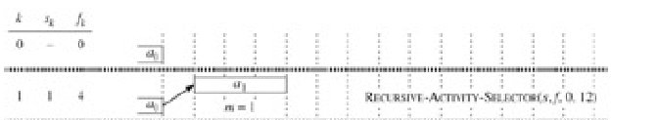
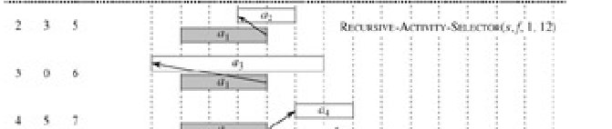
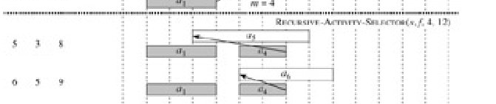
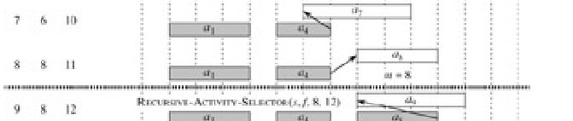
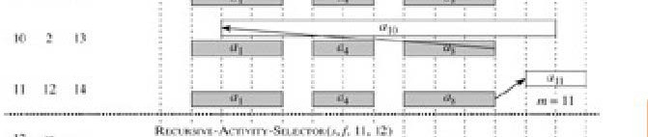
A recursive greedy algorithm
Initial call: REC-ACTIVITY-SELECTOR(s, f, 0, n).
Idea: The while loop checks a_{i+1} , a_{i+2} , . . . , a_{n} until it finds an activity a_{m} that is compatible with a_{i} (need s_{m}≥ f_{i} ).
If the loop terminates because a_{m} is found (m≤n), then recursively solve S_{m,n+1}, and return this solution, along with a_{m}.
If the loop never finds a compatible a_{m} (m > n), then just return empty set.

Slide 24
An iterative greedy algorithm
REC-ACTIVITY-SELECTOR is almost "tail recursive“.
We easily can convert the recursive procedure to an iterative one. (Some compilers perform this task automatically)
GREEDY-ACTIVITY-SELECTOR(s, f, n)
1 A ← {a1}
2 i ← 1
3 for m ← 2 to n
4 do if sm ≥ fi
5 then A←A∪{am}
6 i← m // ai is most recent addition to A
7 return A
×
a_{m}
√
a_{m}
a_{i}
a_{i}

Slide 25
Review
Greedy Algorithm Idea: When we have a choice to make, make the one that looks best right now. Make a locally optimal choice in hope of getting a globally optimal solution.（希望当前选择是最好的，每一个局部最优选择能产生全局最优选择）
Greedy Algorithm: Simpler, more efficient

Slide 26
Greedy Algorithms
1, the activity-selection problem （活动安排）
2, basic elements of the GA; knapsack prob.（贪婪算法的基本特征；背包问题）
3, an important application: the design of data compression (Huffman) codes. （哈夫曼编码）

Slide 27
Elements of the greedy strategy
The choice that seems best at the moment is chosen.（每次决策时，当前所做的选择看起来是“最好”的）
What did we do for activity selection?
Determine the optimal substructure.
Develop a recursive solution.
Prove that at any stage of recursion, one of the optimal choices is the greedy choice.
Show that all but one of the subproblems resulting from the greedy choice are empty. （通过贪婪选择，只有一个子问题非空）
Develop a recursive greedy algorithm.
Convert it to an iterative algorithm.

Slide 28
Elements of the greedy strategy
These steps looked like dynamic programming.
Typically, we streamline these steps （简化这些步骤）
Develop the substructure with an eye toward
making the greedy choice,
leaving just one subproblem.
For activity selection, we showed that the greedy choice implied that in S_{ij} , only i varied, and j was fixed at n+1,
So, we could have started out with a greedy algorithm in mind:
define S_{i} = {a_{k} ∈ S : f_{i} ≤ s_{k} }, （所有在 ai 结束之后开始的活动）
show the greedy choice, first a_{m} to finish in S_{i}
combined with optimal solution to S_{m}
⇒ optimal solution to S_{i} .

Slide 29
Elements of the greedy strategy
Typical streamlined steps （简化这些步骤）
Cast the optimization problem as one in which we make a choice and are left with one subproblem to solve.（最优问题为：做一个选择，留下一个待解的子问题）
Prove that there’s always an optimal solution that makes the greedy choice, so that the greedy choice is always safe.（证明存在一个基于贪婪选择的最优解，因此贪婪选择是安全的）
Show that greedy choice and optimal solution to subproblem ‹ optimal solution to the problem.（说明由贪婪选择和子问题的最优解 ‹ 原问题的最优解）

Slide 30
Elements of the greedy strategy
No general way to tell if a greedy algorithm is optimal, but two key ingredients are（没有一般化的规则来说明贪婪算法是否最优，但有两个基本要点）
greedy-choice property （贪婪选择属性）
optimal substructure

Slide 31
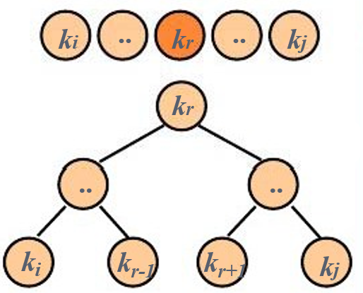
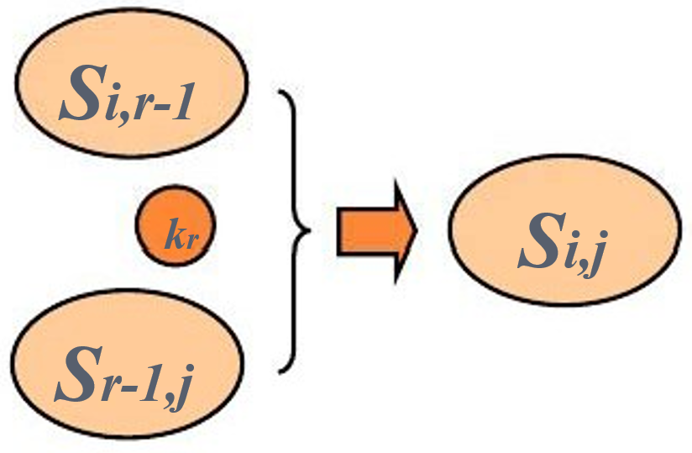
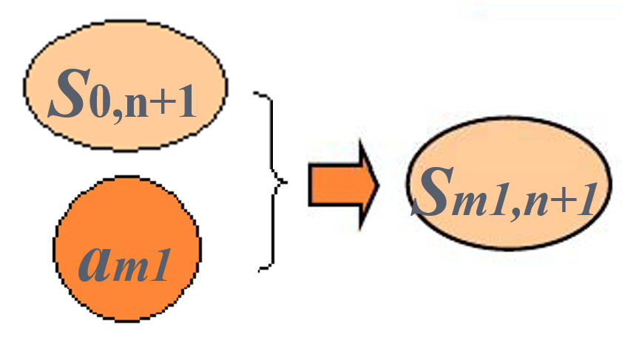
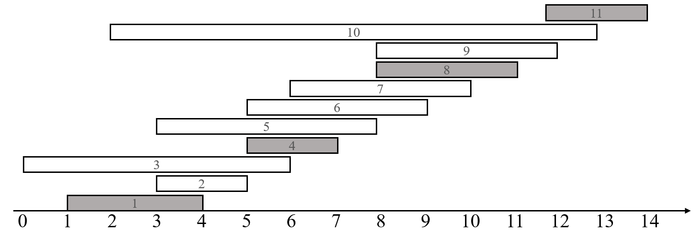
Greedy-choice property
A globally optimal solution can be arrived at by making a locally optimal (greedy) choice. （通过局部最优解可导出全局最优解）
Dynamic programming
Make a choice at each step.
Choice depends on knowing optimal solutions to subproblems. Solve subproblems first. （依赖于已知子问题的最优解再作出选择）
Solve bottom-up.
Greedy
Make a choice at each step.
Make the choice before solving the subproblems. （先作选择，再解 子问题）
Solve top-down.

Slide 32
Greedy-choice property
We must prove that a greedy choice at each step yields a globally optimal solution. Difficulty! Cleverness may be required!
Typically, Theorem 16.1, shows that the solution (A_{ij}) can be modified to use the greedy choice (a_{m}), resulting in one similar but smaller subproblem (A_{mj}).
We can get efficiency gains from greedy-choice property. (For example, in activity-selection, sorted the activities in monotonically increasing order of finish times, needed to examine each activity just once.)
Preprocess input to put it into greedy order

Slide 33
Optimal substructure
optimal substructure: an optimal solution to the problem contains within it optimal solutions to subproblems.
Just show that optimal solution to subproblem and greedy choice ⇒ optimal solution to problem.（说明子问题的最优解和贪婪选择) ⇒原问题的最优解

Slide 34
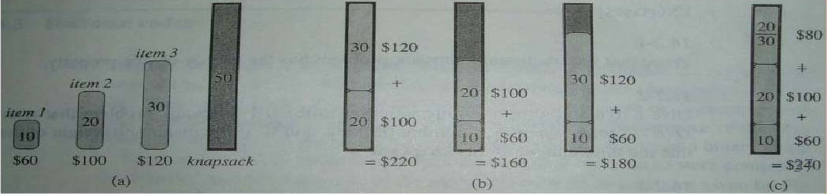
Greedy vs. dynamic programming
bread
cake
pizza
cellphone
camera
laptop
0-1 knapsack problem （ 0-1背包问题，小偷问题）
n items （n 个物品）
Item i is worth $v_{i} , weighs w_{i} P（物品i 价值v_{i} ，重w_{i}）
Find a most valuable subset of items with total weight ≤W.（背包的最大负载量为W，如何选取物品，使得背包装的物品价值最大）
Have to either take an item or not take it can’t take part of it.（每个物品是一个整体，不能分割，因此，要么选取该物品，要么不选取）
Fractional knapsack problem （分数背包问题，小偷问题）
Like the 0-1 knapsack problem, but can take fraction of an item.

Slide 35
Greedy vs. dynamic programming
0-1 knapsack problem （ 0-1背包问题，小偷问题）
Fractional knapsack problem （分数背包问题，小偷问题）
Both have optimal substructure property.
0-1 : choose the most valuable load j that weighs w_{j} ≤ W, remove j , choose the most valuable load i that weighs w_{i} ≤W-w_{j}
fractional: choose a weight w from item j ( part of j ), then remove the part, the remaining load is the most valuable load weighing at most W-w that the thief can take from the n-1 original items plus w_{j}-w pounds from item j.（若先选 item j 的一部分，其重 w ，则接下来的最优挑选方案为从余 下的 n-1 个物品〔除 j 外〕和 j 的另外重 wj-w 的部分中挑选，其重量不超过 W-w ）
But the fractional problem has the greedy-choice property, and the 0-1 problem does not.

Slide 36
Greedy vs. dynamic programming
Fractional knapsack problem has the greedy-choice property, and the 0-1 knapsack problem does not.
To solve the fractional problem, rank decreasingly items by v_{i} /w_{i}
Let v_{i} /w_{i} ≥ v_{i+1} /w_{i+1}
for all _{i}
Time: O(nlg n) to sort, O(n) to greedy choice thereafter.
FRACTIONAL-KNAPSACK(v,w,W)
1 load ← 0
2 i ← 1
3 while load < W and i ≤ n
do if wi ≤ W - load
then take all of item i
else take W-load of wi from item i
add what was taken to load
8 i ←i + 1

Slide 37
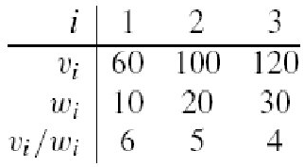
Greedy vs. dynamic programming
0-1 knapsack problem has not the greedy-choice property
W = 50.
Greedy solution:
take items 1 and 2
value = 160, weight = 30
20 pounds of capacity leftover.
Optimal solution:
Take items 2 and 3
value=220, weight=50
No leftover capacity.（没有剩余空间）
bread
cake
pizza
cellphone
camera
laptop

Slide 38
Greedy Algorithms
1, the activity-selection problem （活动安排）
2, basic elements of the GA; knapsack prob.（贪婪算法的基本特征；背包问题）
3, an important application: the design of data compression (Huffman) codes. （哈夫曼编码）

Slide 39
Huffman codes
Huffman codes: widely used and very effective technique for compressing data.
savings of 20% to 90%
Consider the data to be a sequence of characters
Abaaaabbbdcffeaaeaeec
Huffman's greedy algorithm:
uses a table of the frequencies of occurrence of the characters to build up an optimal way of representing each character as a binary string.（依据字符出现的频率表，使用二进串来建立一种表示字符的最佳方法）

Slide 40
Huffman codes
Wish to store compactly 100,000-character data file
only six different characters appear. frequency table
Many ways (encodes) to represent such a file of information
binary character code (or code for short): each character is represented by a unique binary string.
fixed-length code: if use 3-bit codeword, the file can be encoded in 300,000 bits. Can we do better?
 | a | b | c | d | e | f
Frequency (in thousands) | 45 | 13 | 12 | 16 | 9 | 5
Fixed-length codeword | 000 | 001 | 010 | 011 | 100 | 101
Variable-length codeword | 0 | 101 | 100 | 111 | 1101 | 1100

Slide 41
Huffman codes
100,000-character data file
binary character code (or code for short)
variable-length code: by giving frequent characters short codewords and infrequent characters long codewords, here the 1-bit string 0 represents a, and the 4-bit string 1100 represents f. （高频出现的字符以短字码表示； 低频→长字码）
(45·1 + 13·3 + 12·3 + 16·3 + 9·4 + 5·4) · 1,000 = 224,000 bits
 | a | b | c | d | e | f
Frequency (in thousands) | 45 | 13 | 12 | 16 | 9 | 5
Fixed-length codeword | 000 | 001 | 010 | 011 | 100 | 101
Variable-length codeword | 0 | 101 | 100 | 111 | 1101 | 1100

Slide 42
Huffman codes
100,000-character data file
binary character code (or code for short)
fixed-length code: 300,000 bits
variable-length code: 224,000 bits, a savings of approximately 25%. In fact, this is an optimal character code for this file.
 | a | b | c | d | e | f
Frequency (in thousands) | 45 | 13 | 12 | 16 | 9 | 5
Fixed-length codeword | 000 | 001 | 010 | 011 | 100 | 101
Variable-length codeword | 0 | 101 | 100 | 111 | 1101 | 1100

Slide 43
Prefix codes
prefix codes (prefix-free codes): no codeword is a prefix of some other codeword. （字首码，前缀代码，前置代码〔前缀无关码〕 ：没有字码是 其他字码的前缀）
Encoding （编码） is always simple for any binary character code
Concatenate（ 连 接 ） the codewords representing each character. For example, “abc”, with the variable-length prefix code as 0·101·100 = 0101100, where we use ‘·’ to denote concatenation.
Prefix codes simplify decoding （解码）
 | a | b | c | d | e | f
Frequency (in thousands) | 45 | 13 | 12 | 16 | 9 | 5
Fixed-length codeword | 000 | 001 | 010 | 011 | 100 | 101
Variable-length codeword | 0 | 101 | 100 | 111 | 1101 | 1100

Slide 44
Prefix codes
prefix codes (prefix-free codes): no codeword is a prefix of some other codeword. （字首码，前缀代码，前置代码〔前缀无关码〕 ：没有字码是 其他字码的前缀）
Encoding is always simple for any binary character code
Prefix codes simplify decoding
Since no codeword is a prefix of any other, the codeword that begins an encoded file is unambiguous（明确的）.
We can simply identify the initial codeword, translate it back to the original character, and repeat the decoding process on the remainder of the encoded file.
Exam: 001011101 uniquely as 0·0·101·1101, which decodes to “aabe”.
 | a | b | c | d | e | f
Variable-length codeword | 0 | 101 | 100 | 111 | 1101 | 1100

Slide 46
编码树
边标记: 左边标记0，右侧边标记1
100
0
1
a: 45
55
1
0
内结点: 用其子树的叶结点的频率和标记
25
30
0
1
0
1
c: 12
b: 13
14
d: 16
0
1
叶结点: 用字符及其出现频率标记
f: 5
e: 9

Slide 47
编码树T的代价
设C是字母表,∀c∈C
f(c)是c在文件中出现的频率
d_{T}(c)是叶子c在树T中的深度，即c的编码长度
T的代价是编码一个文件的所有字符的代码位数:
B(T)=

Slide 48
优化编码树问题
输入: 字母表 C = {c₁, c₂, ...., c_{n} }，
频率表 F = {f(c₁), f(c₂), ..., f(c_{n})}
输出: 具有最小B(T)的C前缀编码树
贪心思想：
循环地选择具有最低频率的两个结点，
生成一棵子树，直至形成树

Slide 49
优化解的结构分析
我们需要证明
优化前缀树问题具有优化子结构
优化前缀树问题具有贪心选择性

Slide 50
优化子结构
引理1.设T是字母表C的优化前缀树，∀c∈C，f(c)
是c在文件中出现的频率.设x、y是T中任意两个相邻叶结点，z是它们的父结点，则z作为频率是f(z)=f(x)+f(y)的字符，T’=T-{x,y}是字母表C’=C-{x,y}∪{z}的优化前缀编码树.
T
0
1
T’
f(b)
0
1
1
b
0
f(b)
0
1
b
f(c)
z
c
0
1
f(c)
z
f(x)+f(y)
c
f(x)
x
y
f(y)

Slide 51
证. 证B(T)=B(T’)+f(x)+f(y).
∀v∈C-{x,y}, d_{T}(v)=d_{T’}(v), f(v)d_{T}(v)=f(v)d_{T’}(v).
由于 d_{T}(x)=d_{T}(y)=d_{T’}(z)+1,
f(x)d_{T}(x)+f(y)d_{T}(y)
=(f(x)+f(y))(d_{T’}(z)+1)
=(f(x)+f(y))d_{T’}(z)+(f(x)+f(y))
由于 f(x)+f(y)=f(z), f(x)d_{T}(x)+f(y)d_{T}(y)=f(z)d_{T’}(z)+(f(x)+f(y)).
于是B(T)=B(T’)+f(x)+f(y).
若T’不是C’的优化前缀编码树，
则必存在T’’，使B(T’’)<B(T’).
因为z是C’中字符，它必为T’’中的叶子.
把结点x与y加入T’’，作为z的子结点，
则得到C的一个如下前缀编码树T’’’：
T’
0
1
b
f(b)
0
1
f(c)
c
z
f(x)+f(y)
T’’
0
1
u
f(u)
0
1
v
f(v)
z
f(z)

Slide 52
T’’’
T’’
0
1
0
1
u
f(u)
0
1
u
f(u)
0
1
f(v)
z
v
f(v)
0
1
v
z
f(z)
f(x)
x
y
f(y)
T’’’代价为：
B(T’’’)= ……+(f(x)+f(y))(d_{T’’}(z)+1)
= ……+f(z)d_{T’’}(z)+(f(x)+f(y)) (d_{T’’}(z)=d_{T’}(z))
= B(T’’)+f(x)+f(y)<B(T’)+f(x)+f(y)= B(T)
与T是优化的矛盾，故T’是C’的优化编码树.

Slide 53
贪心选择性
引理2. 设C是字母表，∀c∈C，c具有频率f(c), x、y
是C中具有最小频率的两个字符，则存在一个C的优化前缀树，x与y的编码具有相同长度，且仅在最末一位不同.

Slide 54
证: 设T是C的优化前缀树，且b和c是具有最大深度的两个兄弟字符:
T
x
y
b
c
不失一般性，设f(b)≤f(c), f(x)≤f(y). 因x与y是具有
最低频率的字符, f(b)≥f(x), f(c)≥f(y).交换T的b和x,从T构造T′ :

Slide 55
T’
T’’
b
b
交换y和c
构造T′′
y
c
x
c
x
y

Slide 56
证T′′是最优化前缀树.
B(T)-B(T′)
=
= f(x)d_{T}(x) + f(b)d_{T}(b) - f(x)d_{T’}(x) - f(b)d_{T’}(b)
= f(x)d_{T}(x) + f(b)d_{T}(b) - f(x)d_{T}(b) - f(b)d_{T}(x)
= (f(b)-f(x))(d_{T}(b)-d_{T}(x)).
∵ f(b)≥f(x), d_{T}(b)≥d_{T}(x) (因为b的深度最大)
∴ B(T)-B(T’)≥0, B(T)≥B(T’)
同理可证B(T’)≥B(T’’). 于是B(T)≥B(T’’).
由于T是最优化的，所以B(T)≤B(T’’).
于是, B(T)=B(T’’)，T’’是C的最优化前缀编码树.
在T’’中, x和y具有相同长度编码, 且仅最后一位不同.

Slide 57
正确性证明
定理. Huffman算法产生一个优化前缀编码树
证. 由于引理1、引理2成立,而且Huffman算法按照引理2的贪心选择性确定的规则进行局部优化选择，所以Huffman算法产生一个优化前缀编码树。

